Slide 1
Back to School Night 2022
Mrs. Raguz

Slide 2
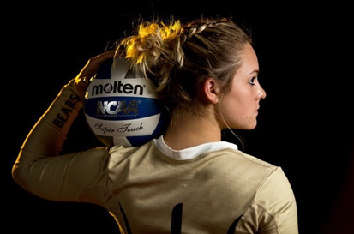
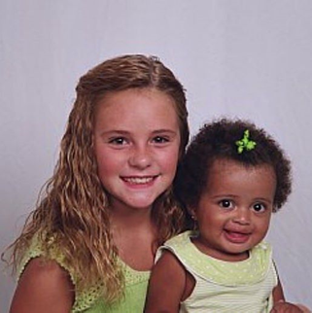
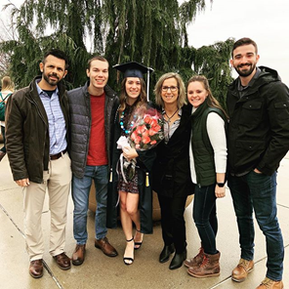
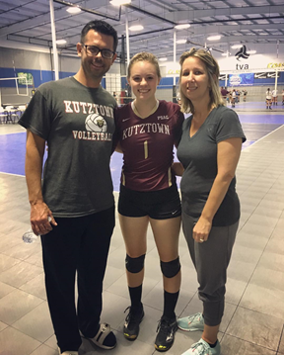
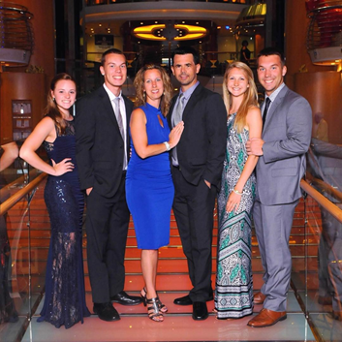
About Me
Grew up in Southern Indiana
Lebanon, Pennsylvania – Northern Lebanon High School
D2 Athletic Scholarship – Volleyball Kutztown University

Slide 3
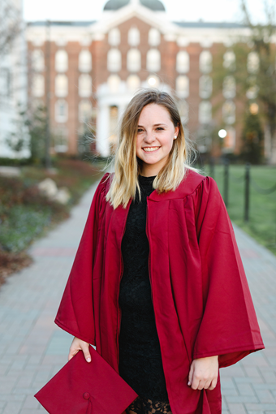
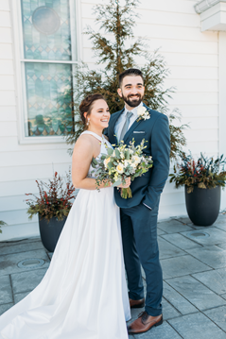
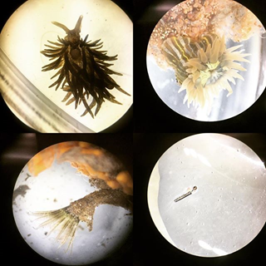
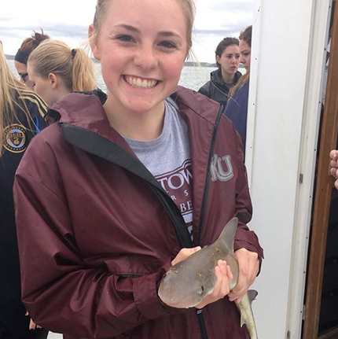
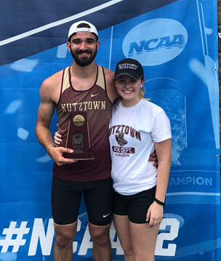
About Me
B.S. Marine Science: Biology & B.S. Biology: Organismal/Ecology (2018)
M.Ed Secondary Education (2019)
Husband: Brandon
Year 3 of teaching!
Lacey High School
Wall High School
OCVTS - PAA

Slide 4
Syllabus
Biology:
https://docs.google.com/document/d/14usMH-6NgOVKDB6hCTfTzOPadjQwjzzkIbZcHZiw178/edit?usp=sharing
AP Environmental Science: https://docs.google.com/document/d/1tSH6Cgb-WHMyniYPyX_9irXD_jQirYH_FLC4HPt52Rg/edit?usp=sharing

Slide 5
Daily Classroom Procedures & Grades
Science Starter
Google Classroom
Textbook
Labs
Gradebook

Slide 6
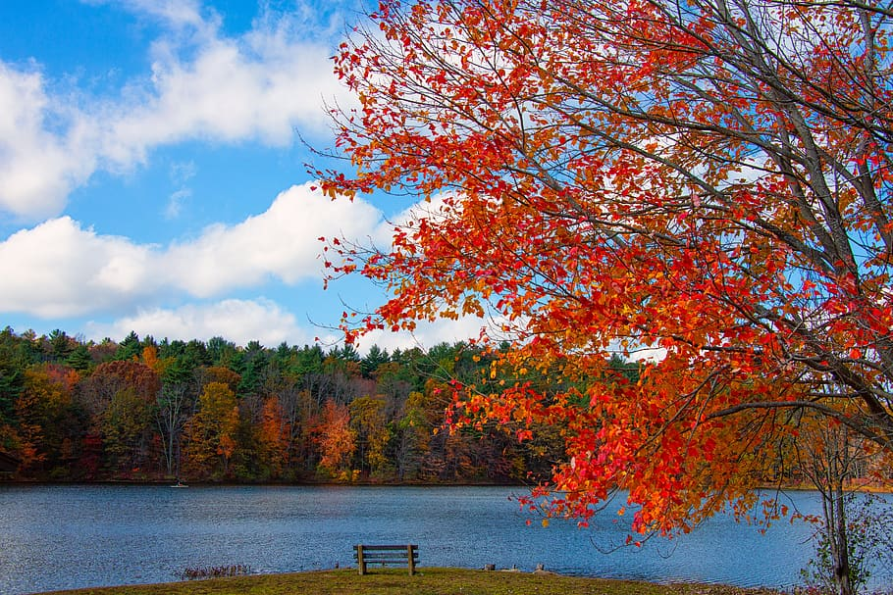
I am looking forward to continue to get to know your students & explore science with them!
If you have any questions or concerns during the year, feel free to email me!
mraguz@barnegatschools.com

